Slide 1


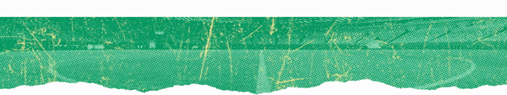
Twitter Data Analysis
CS 226: BIG-DATA MANAGEMENT, Fall 2022
Group number 11: Fantastic4
Vineet Dhaimodker Vishv Patel
Mihir Patel Yash Gandhi
Notes:
Hi guys, we are the fantastic four and our project is Twitter data analysis for fifa worldcup qatar 2022.

Slide 2
Table of Contents
Background & Motivation
Data Gathering
Evaluation
Relevance of our work
Data Pre-processing
Related Work
Overview of work done
Sentiment analysis
Conclusion
Visualization Dashboard Demo
Notes:
This are the topics for todays presentation.

Slide 3
Background & Motivation
1
FIFA World Cup is the most viewed event with about 3.5 billion followers worldwide and the 2018 FIFA World Cup generated more than 5 billion USD of revenue in total
Twitter conversations regarding the same keep growing with a total of 41 million tweets related to soccer in UK alone, since the beginning of the year
2
Visualizing twitter data can benefit the marketers to analyze reports, interests, evaluate performance of strategies
Sentiment analysis helps to find hidden patterns such as brand perception which is a massive factor for large businesses
Notes:
First we will look at the backgroud for this project
The number of soccer fans has rapidly increased with about 3.5 Billion fans all over the world.
This has inturn led to FIFA world cup generating tremendous amount of revenue.
The 2018 wold cup alone generated a total revenue of around 5 billion USD.
With these facts in mind, soccer fans on twitter are now more active then ever.
Fans took to twitter to express their feelings.
Now we will take a look at the motivation for this project
Grasping visual data is simpler than textual form and makes it easier to stress on the crucial information of the data
Visualizing FIFA world cup tweet data will help businesses improve marketing strategies and better reach their target demographic
Analyzing sentiments of fans will help brands in industries like sports apparel, clothing, travel, supplements, etc. to improve product quality and customer satisfaction.
Considering these facts, with this project we aim to visualize and perform sentiment analysis on tweets related to FIFA World Cup 2022

Slide 4
Relevance of work
Perfect example of big data as it follows the four V’s of Big Data
Excellent source to understand the ground truths behind occurrence of global events
Businesses use it for marketing, growth and development and take feedback from their followers for consistent improvement
Increase in tweets
425%
World cup tweet trend from February to March 2022
Notes:
next we will see why we chose twitter as our data source Firstly, social media is a perfect example of big data
Studies have shown that twitter is a good source to know how people react to global events Due to the influence of this platform on the lives of millions of people, businesses can also use twitter for marketing and consistent growth In a recent blog post, twitter released some interesting insights of tweets regarding the FIFA World Cup. There has been an 425% increase in tweets from February to March. twitter conversations regarding the world cup have kept growing with a total of 41 million tweets in UK alone, in 2022 alone And the most interesting fact is that 53% of people on twitter are fans of the world cup

Slide 5
Relevance of work
Perfect example of big data as it follows the four V’s of Big Data
Excellent source to understand the ground truths behind occurrence of global events
Businesses use it for marketing, growth and development and take feedback from their followers for consistent improvement
Data size
~14GB
Total size of tweet data gathered
Notes:
next we will see why we chose twitter as our data source Firstly, social media is a perfect example of big data
Studies have shown that twitter is a good source to know how people react to global events Due to the influence of this platform on the lives of millions of people, businesses can also use twitter for marketing and consistent growth In a recent blog post, twitter released some interesting insights of tweets regarding the FIFA World Cup. There has been an 425% increase in tweets from February to March. twitter conversations regarding the world cup have kept growing with a total of 41 million tweets in UK alone, in 2022 alone And the most interesting fact is that 53% of people on twitter are fans of the world cup

Slide 6
Relevance of work
Perfect example of big data as it follows the four V’s of Big Data
Excellent source to understand the ground truths behind occurrence of global events
Businesses use it for marketing, growth and development and take feedback from their followers for consistent improvement
Soccer related tweets
Data size
5M
~14GB
FIFA World cup related Tweets gathered since the beginning of 2022
Total size of tweet data gathered
Notes:
next we will see why we chose twitter as our data source Firstly, social media is a perfect example of big data
Studies have shown that twitter is a good source to know how people react to global events Due to the influence of this platform on the lives of millions of people, businesses can also use twitter for marketing and consistent growth In a recent blog post, twitter released some interesting insights of tweets regarding the FIFA World Cup. There has been an 425% increase in tweets from February to March. twitter conversations regarding the world cup have kept growing with a total of 41 million tweets in UK alone, in 2022 alone And the most interesting fact is that 53% of people on twitter are fans of the world cup

Slide 7
Relevance of work
Perfect example of big data as it follows the four V’s of Big Data
Excellent source to understand the ground truths behind occurrence of global events
Businesses use it for marketing, growth and development and take feedback from their followers for consistent improvement
Soccer related tweets
Data size
Relevant hashtags
5M
~14GB
53
FIFA World cup related Tweets gathered since the beginning of 2022
Total size of tweet data gathered
Trending twitter hashtags for FIFA Worldcup 2022
Notes:
next we will see why we chose twitter as our data source Firstly, social media is a perfect example of big data
Studies have shown that twitter is a good source to know how people react to global events Due to the influence of this platform on the lives of millions of people, businesses can also use twitter for marketing and consistent growth In a recent blog post, twitter released some interesting insights of tweets regarding the FIFA World Cup. There has been an 425% increase in tweets from February to March. twitter conversations regarding the world cup have kept growing with a total of 41 million tweets in UK alone, in 2022 alone And the most interesting fact is that 53% of people on twitter are fans of the world cup

Slide 8
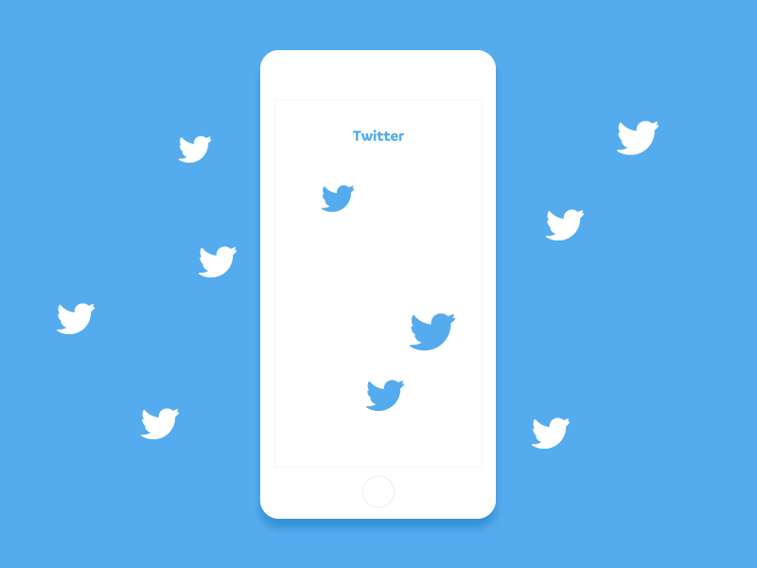
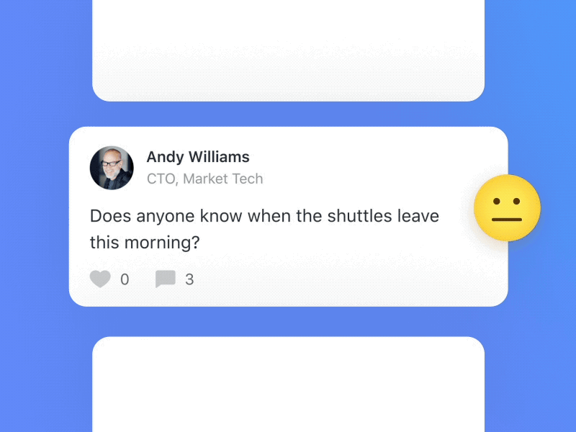

Data Preprocessing
Data Gathering
Sentiment Analysis
Project Overview
1
3
PySpark and Hadoop for handling and processing the big data. NLTK libraries to process tweets for Sentiment Analysis.
2
Extracted FIFA 2022 World cup tweets for trending hashtags using snscrape. Collected almost 14GB data
We will be using Machine learning model on Tweets to classify the Sentiments such as Logistic Regressio and Naive Bayes.
Notes:
To give an overview of this project
We begin with collecting fifa 2022 teets using snscrape where we collected almost 14 GB data
We then prepocess this data using Hadoop and pyspark . And use nltk for cleaning data from sentiment analysis
Next we use logistic regression and naïve bayes for sentiment analysis

Slide 9
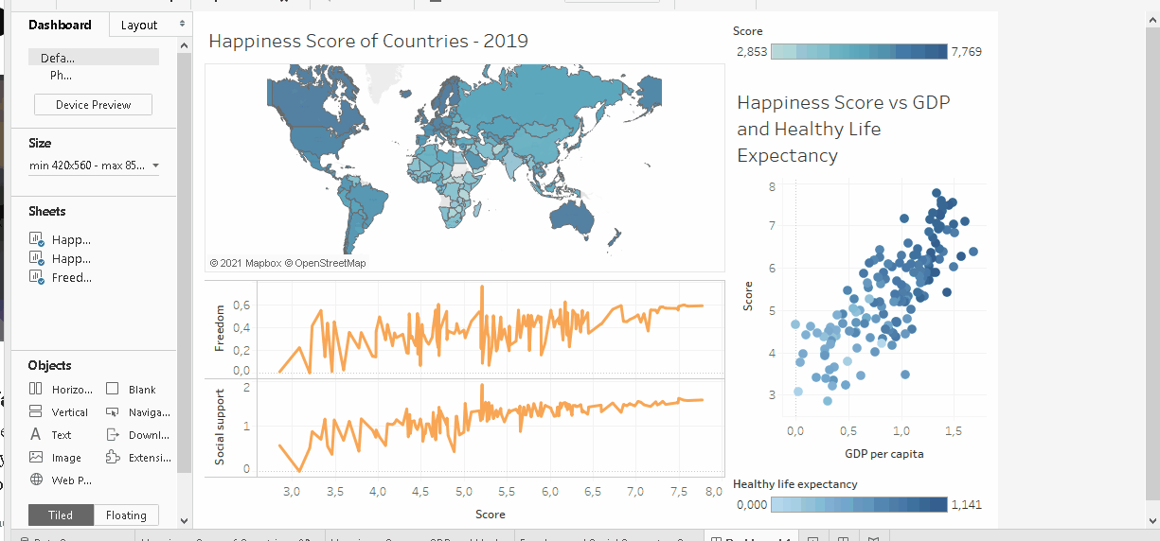

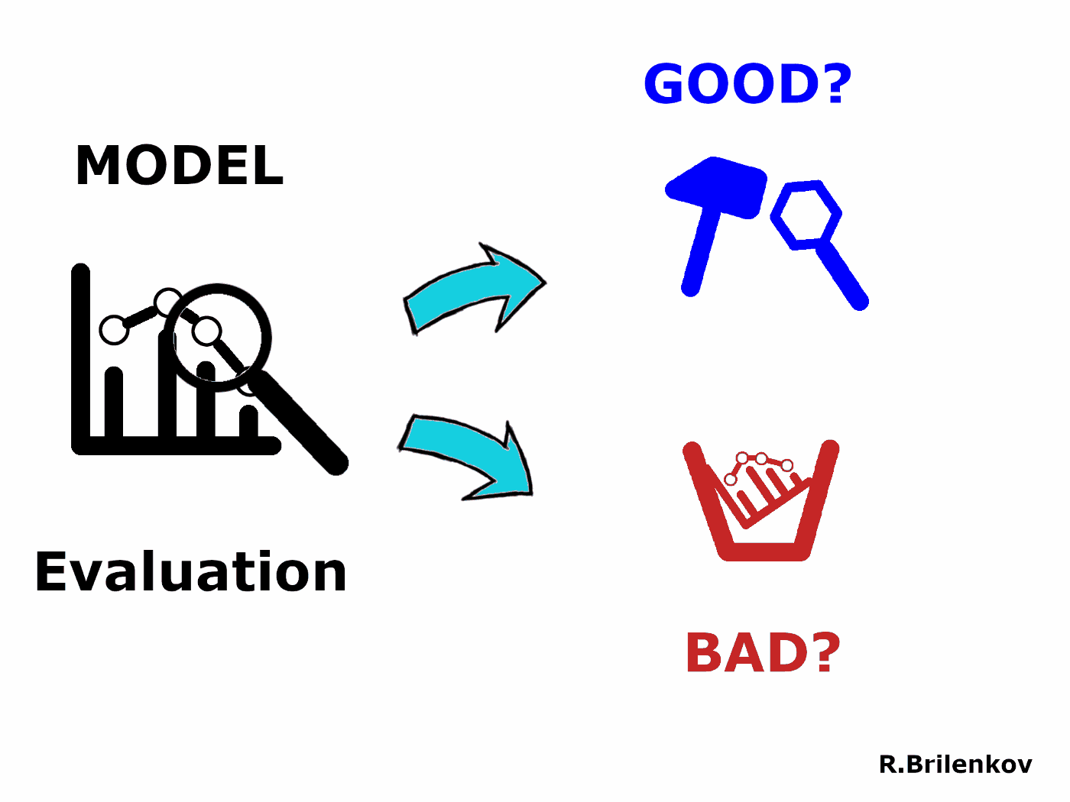
Evaluation
Data Visualization
Conclusion
Project Overview
4
6
We evaluate the sentiment analysis models using standard evaluation metrics. We also calculate the query response time to evaluate scalability
5
React JS with its map and chart components helps to create a dashboard to visualize distribution of tweets based on sentiments, topics, mapping tweets on world map
Supervised ML models were used to learn sentiments from the custom dataset and the accuracy of Naïve Bayes and Logistic regression was evaluated and compared
Notes:
To give an overview of this project
We begin with collecting fifa 2022 teets using snscrape where we collected almost 14 GB data
We then prepocess this data using Hadoop and pyspark . And use nltk for cleaning data from sentiment analysis
Next we use logistic regression and naïve bayes for sentiment analysis
Then we have built a visualization dashboard using react to visualize insights
Further we evaluate the sentiment analysis models using standard metrics ad the scalability of the dashboard using query response times.
Finally we present conclusions for the project along with some ideas for improvements

Slide 10
Data Gathering - SNScrape
Disadvantage of Twitter API
limitations on the number of requests : 900 requests/15-minutes
Timeline of data extraction: January 2022 – November 2022
Hashtags
Trending: fifaworldcup, FIFAWorldCup2022, FIFAWorldCupQatar2022
Teams: threelions (England), usmnt (USA)
Matches: qatarvsecuador, qtrecu, porarg
Extracted ~14 GB of twitter data with almost 5 million tweets.
Notes:
There will be 2 outcomes for our project-
First: visualization Dashboard: We'll display top N tweets based on locations, likes, etc. We will also be plotting tweets on a world map for better visualization
Second will be sentiment analysis: We'll classify tweets based on sentiment score to gain insights into people's reactions.

Slide 11


Data Pre-processing: technology stack
1
We store the data in the Hadoop cluster. This replicates the data into multiple datanodes.
2
We used spark to process the data which we take from the HDFS and used PySpark for further processing the data
Notes:
The project consists of analysis of tweet sentiments and extracting general opinions of the people with regards to FIFA world cup. The project employed NLTK to clean and process the data. Textblob was used to extract tweets polarity. Supervised ML models were used to learn sentiments from the custom dataset and the accuracy of Naïve Bayes and Logistic regression was evaluated and compared. An interactive visualization dashboard will be built to help businesses manage customer demographic statistics. The interactive dashboard tool will be evaluated based on query response times to check for scalability.
Currently, we are limiting our dataset for sentiment analysis to the most common language, which is English, but using translating libraries can help us to expand this to multiple languages. In the future, Deep learning model could be implemented to improve the accuracy of sentiment analysis. Transformer models like BERT and ELMO which have proved to have state-of-the-art performances for Sentiment analysis could be fine-tuned for this application. More interactive dashboard which has more query input fields depending on customer requirement could be built. Live tweet visualization could be the next feature to add to this dashboard tool which will visualize tweets based on specified timeframes.

Slide 12
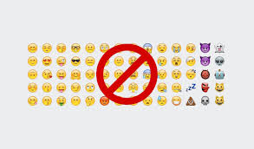

Data Pre-processing
1
We have only used Tweets posted in English.
Removing the Null values, Emoji, number and username from the content column of the data.
2
Using the inbuilt NLTK library functions we removed the stop words.
We used lemmatization to make the model more accurate
Notes:
The project consists of analysis of tweet sentiments and extracting general opinions of the people with regards to FIFA world cup. The project employed NLTK to clean and process the data. Textblob was used to extract tweets polarity. Supervised ML models were used to learn sentiments from the custom dataset and the accuracy of Naïve Bayes and Logistic regression was evaluated and compared. An interactive visualization dashboard will be built to help businesses manage customer demographic statistics. The interactive dashboard tool will be evaluated based on query response times to check for scalability.
Currently, we are limiting our dataset for sentiment analysis to the most common language, which is English, but using translating libraries can help us to expand this to multiple languages. In the future, Deep learning model could be implemented to improve the accuracy of sentiment analysis. Transformer models like BERT and ELMO which have proved to have state-of-the-art performances for Sentiment analysis could be fine-tuned for this application. More interactive dashboard which has more query input fields depending on customer requirement could be built. Live tweet visualization could be the next feature to add to this dashboard tool which will visualize tweets based on specified timeframes.

Slide 13
Sentiment analysis
1
Finding Sentiments of Tweets
We have used TextBlob library for sentiment calculation.
It takes filtered tweet as input and finds its polarity on a scale of –1 to 1.
Based on polarity sentiment is assigned.
Polarity | Sentiment value | Sentiment
0 | 0 | Neutral
(0,1] | 1 | Positive
[-1,0) | 2 | Negative
Notes:
Hello I am Mihir Patel. I will be talking about sentiment analysis.
We have used Textblob library which helps in finding the polarity of tweets. It is very useful library for analysisng on textual data.
It will take tweets content, tokenize it and calculates scores based on polarity of each token.
We have assigned sentiment value …….

Slide 14
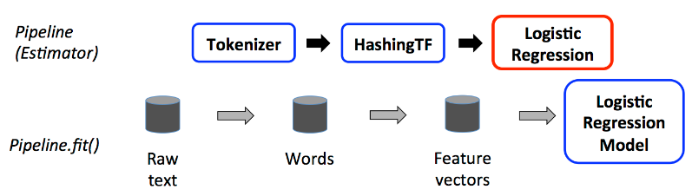
Sentiment analysis
2
Sentiments Classification
Logistic Regression and Naïve Bayes classification algorithms are used to classify sentiments.
Accuracy of Logistic Regression and Naïve Bayes is 89% and 71% respectively.
Notes:
We have implemented two classification algorithms using pyspark mllib.
Logis…. And Naïve …
For this we have build ppipeline which consists of stages like tokenizer which …. , Hashing TF to caclculate TFIDF and then the ML model.
Building pipeline helps in scalabilty
That’s why we used Pyspark.

Slide 15
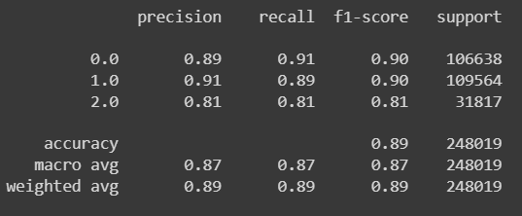
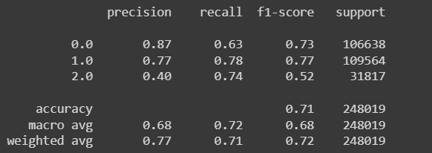
Evaluation
Logistic Regression
Naïve Bayes
Notes:
Accuracy of LR = 89 and Naïve Bayes is 71.
Also you can see precision of sentiment 2 i.e negative value if just 40% meaning from all negative sentiments predicted only 40% of them were actually negative

Slide 16
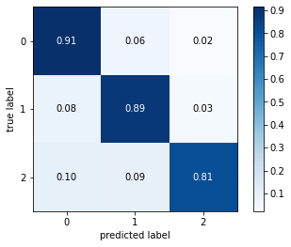
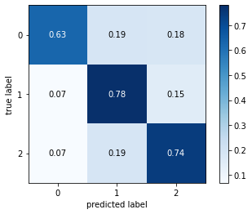
Evaluation
Logistic Regression
Naïve Bayes
Notes:
Confusion matrix.
We can see neutral values in LR is 91% True classified however only 63% in Naïve Bayes

Slide 17
Queries Evaluation
Top N likeCount on same dataset
1
Top | Query time
1 | 8.243618249893188
100 | 8.63142704963684
1000 | 9.92312479019165
We have used df.top(n, key) query to find top N like counts. It returns most liked tweet first.
It require dataframe to be stored in memory. For that reason, we created RDD of necessary columns only.
Notes:
There will be 2 outcomes for our project-
First: visualization Dashboard: We'll display top N tweets based on locations, likes, etc. We will also be plotting tweets on a world map for better visualization
Second will be sentiment analysis: We'll classify tweets based on sentiment score to gain insights into people's reactions.

Slide 18
Queries Evaluation
Top 10 likeCount on different dataset
1
Data Size | Query time
60mb | 3.147566556930542
350mb | 8.582376956939697
3.0gb | 115.25807619094849
To understand pyspark sql queries capabilities and limitations we ran same query on different data size like 60mb, 350mb, and 3gb.
Notes:
scalabilty

Slide 19


Visualization Dashboard: technology stack
The Frontend is built using HTML, CSS, JavaScript and React JS.
Various libraries of React JS like react-tables, nivo are also used for effective visualization.
Notes:
There will be 2 outcomes for our project-
First: visualization Dashboard: We'll display top N tweets based on locations, likes, etc. We will also be plotting tweets on a world map for better visualization
Second will be sentiment analysis: We'll classify tweets based on sentiment score to gain insights into people's reactions.

Slide 20
Visualization Dashboard Demo

Slide 21
Related Work
Behavioral analysis on World Cup data
Data Pre-processing
Sentiment Analysis
Data Analysis and Visualization

Slide 22
Conclusion
1
Supervised ML models were used to learn sentiments from the custom dataset and the accuracy of Naïve Bayes and Logistic regression was evaluated and compared
The interactive dashboard tool will be evaluated based on query response times to check for scalability.
2
In the future, Deep learning model could be implemented to improve the accuracy of sentiment analysis, Transformer models like BERT and ELMO
Live tweet visualization could be the next feature to add to this dashboard tool which will visualize tweets based on specified timeframes
Notes:
The project consists of analysis of tweet sentiments and extracting general opinions of the people with regards to FIFA world cup. The project employed NLTK to clean and process the data. Textblob was used to extract tweets polarity. Supervised ML models were used to learn sentiments from the custom dataset and the accuracy of Naïve Bayes and Logistic regression was evaluated and compared. An interactive visualization dashboard will be built to help businesses manage customer demographic statistics. The interactive dashboard tool will be evaluated based on query response times to check for scalability.
Currently, we are limiting our dataset for sentiment analysis to the most common language, which is English, but using translating libraries can help us to expand this to multiple languages. In the future, Deep learning model could be implemented to improve the accuracy of sentiment analysis. Transformer models like BERT and ELMO which have proved to have state-of-the-art performances for Sentiment analysis could be fine-tuned for this application. More interactive dashboard which has more query input fields depending on customer requirement could be built. Live tweet visualization could be the next feature to add to this dashboard tool which will visualize tweets based on specified timeframes.

Slide 23
Interesting fact!
Final: ARG vs POR?
Who do you think will win?
Notes:
a supercomputer has made its prediction for which two teams will be playing in the final on 18 December. According to the research conducted by BCA, Lionel Messi’s Argentina will defeat Cristiano Ronaldo’s Portugal in the final in Qatar in a penalty shootout.
The research was published in a special report called ‘The Most Important Of All Unimportant Forecasts 2nd Edition: 2022 FIFA World Cup.’ BCA based the outcome of the tournament on player statistics from the EA Sport FIFA 2023 game and also sampled 192 group stage games and 64 knockout rounds played from the last four FIFA World Cups.

Slide 24
Thank you

Slide 25
Data Pre-processing
Spark
2
We used spark to process the data which we will take from the HDFS. And pyspark for further processing the data
Notes:
There will be 2 outcomes for our project-
First: visualization Dashboard: We'll display top N tweets based on locations, likes, etc. We will also be plotting tweets on a world map for better visualization
Second will be sentiment analysis: We'll classify tweets based on sentiment score to gain insights into people's reactions.

Slide 26
Data Pre-processing
Hadoop
1
We will store the data at the Hadoop cluster. That will replicate the data into multiple datanodes.
Notes:
There will be 2 outcomes for our project-
First: visualization Dashboard: We'll display top N tweets based on locations, likes, etc. We will also be plotting tweets on a world map for better visualization
Second will be sentiment analysis: We'll classify tweets based on sentiment score to gain insights into people's reactions.

Slide 27
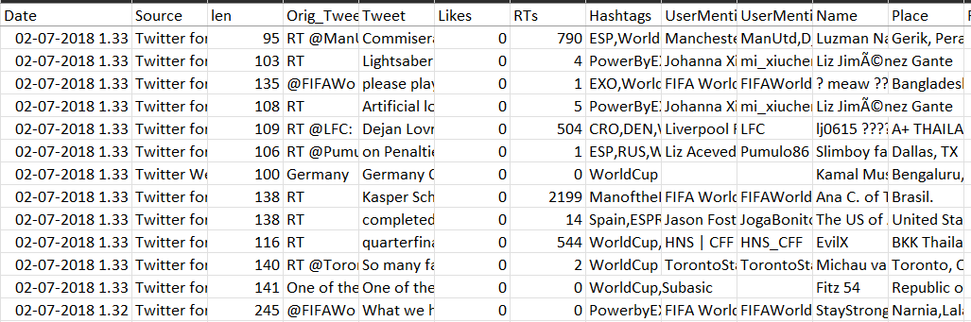


Overview of work done
03
Sample Twitter Dataset
Our dataset will consist of features like date, location, url, text, etc. which are relevant for visualization and sentiment analysis
Twitter Features
Twitter is a big source of data containing many features which is useful for Visualizing and Sentiment Analysis
01
02
Tweepy
Tweepy twitter API to collect tweet data trending hashtags: #FIFAWorldCup, #Qatar2022, #WorldcupQatar2022, etc
Notes:
The inspiration for the dataset is from the Kaggle dataset “FIFA World Cup 2018 Tweets”. The dataset which we will use for the project consists of the data which is being generated as we speak. We would scrape the tweets related to FIFA World Cup 2022 usinig the related hashtags like #FIFAWorldCup, #Qatar2022, #WorldcupQatar2022, etc. We will be using the tweepy twitter API to collect the data.

Slide 28
References
[1] Most Popular Sport by Country 2022. Retrieved October 25, 2022 from https://worldpopulationreview.com/country-rankings/most-popular-sport-by-country
[2] FIFA Financial Report 2018. Retrieved October 25, 2022 from https://digitalhub.fifa.com/m/337fab75839abc76/original/xzshsoe2ayttyquuxhq0-pdf.pdf
[3] How Twitter is counting down to the World Cup. Retrieved October 25, 2022 from https://marketing.twitter.com/en_gb/insights/how-twitter-is-counting-down-to-the-world-cup
[4] Lucas GM, Gratch J, Malandrakis N, Szablowski E, Fessler E, Nichols J. GOAALLL!: Using sentiment in the world cup to explore theories of emotion. Image and Vision
Computing. 2017 Sep 1;65:58-65. DOI: https://doi.org/10.1016/j.imavis.2017.01.006
[5] 4 Benefits of Twitter Sentiment Analysis for Your Business | Scraping . Retrieved October 25, 2022 from https://scrapingrobot.com/blog/twitter-sentiment-analysis/
[6] https://www.kaggle.com/datasets/rgupta09/world-cup-2018-tweets
[7] Discover the 4 V. Retrieved October 25, 2022 from https://opensistemas.com/en/the-four-vs-of-big-data/
[8] Taneja S, Taneja M. Big Data And Twitter. International Journal Of Research In Computer Applications And Robotics. Vol. 2014;2:144-50. ISSN: 2320-7345
[9] Various ways to evaluate a machine learning model. Retrieved October 25, 2022 from https://towardsdatascience.com/various-ways-to-evaluate-a-machine-learning-models-performance-230449055f15
[10] Insights. Retrieved October 25, 2022 from https://marketing.twitter.com/en/insights
[11] White Fifa World Cup 2022 Logo Wallpaper. Retrieved October 25, 2022 from https://wallpapers.com/wallpapers/white-fifa-world-cup-2022-logo-wah9nrnsy9b12kf4.html
[12] Tweepy – Real Python. Retrieved October 25, 2022 from https://realpython.com/twitter-bot-python-tweepy/
[13] Beginners Guide to Data Preprocessing in Machine Learning. Retrieved June 15, 2020 from https://thelastbyteblog.wordpress.com/2020/06/15/beginners-guide-to-data-preprocessing-in-machine-learning/
[14] Sentiment Analysis. Retrieved from https://dribbble.com/shots/4226968-Sentiment-Analysis
[15] World Happiness Dashboard in Tableau. Retrieved Jan 29, 2021 from https://towardsdatascience.com/world-happiness-dashboard-in-tableau-4dc504212288
[16] Icon Logo, Twitter logo, Twitter logo, blue, social Media png | PNGEgg. Retrieved October 25, 2022 from https://www.pngegg.com/en/png-bbtjg
[17] Pipeline image from https://spark.apache.org/docs/latest/ml-pipeline.html

Slide 29
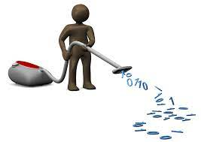
Data Pre-processing
Data Cleaning
1
Tweets of only English language are processed. Removing the Null values, Emoji, number and username from the content column of the data.
Notes:
There will be 2 outcomes for our project-
First: visualization Dashboard: We'll display top N tweets based on locations, likes, etc. We will also be plotting tweets on a world map for better visualization
Second will be sentiment analysis: We'll classify tweets based on sentiment score to gain insights into people's reactions.

Slide 30
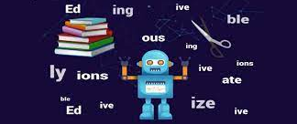
Data Pre-processing
NLTK
2
Using the inbuilt NLTK library functions we removed the stop words. And also, the lemmatization to make the model more accurate
Notes:
There will be 2 outcomes for our project-
First: visualization Dashboard: We'll display top N tweets based on locations, likes, etc. We will also be plotting tweets on a world map for better visualization
Second will be sentiment analysis: We'll classify tweets based on sentiment score to gain insights into people's reactions.

Slide 31
Motivation
Visualizing twitter data can benefit the marketers to analyze reports, interests, evaluate performance of strategies
Sentiment analysis helps to find hidden patterns such as brand perception which is a massive factor for large businesses
1
2
Notes:
Now we will take a look at the motivation for this project
Grasping visual data is simpler than textual form and makes it easier to stress on the crucial information of the data
Visualizing FIFA world cup tweet data will help businesses improve marketing strategies and better reach their target demographic
Analyzing sentiments of fans will help brands in industries like sports apparel, clothing, travel, supplements, etc. to improve product quality and customer satisfaction.
Considering these facts, with this project we aim to visualize and perform sentiment analysis on tweets related to FIFA World Cup 2022

Slide 32
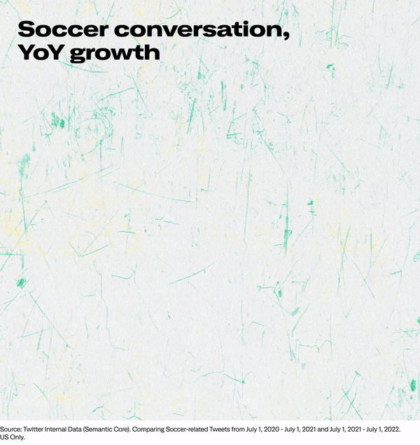
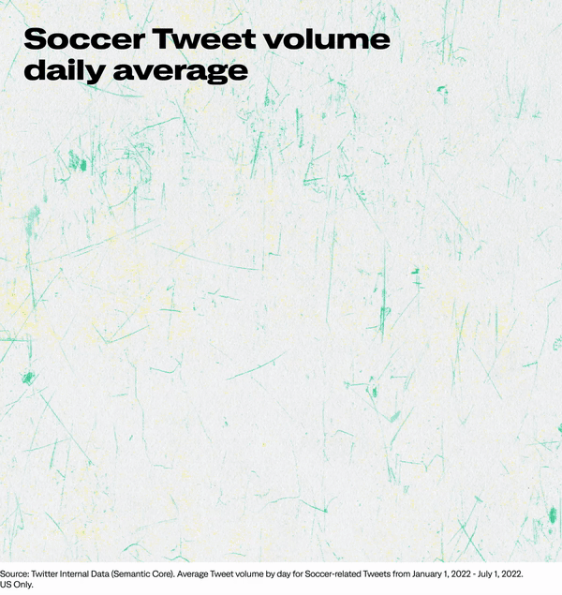
Twitter Trends
Notes:
These are two graphics which show the growth in Soccer tweets the first one shows the tweet volume daily average from Jan 2022 to July 2022 and the second shows the year on year growth in terms of various aspects. But the one we focus on is the brand mentions which have grown by 27%. this shows that businesses using twitter for promoting their brand are increasing
https://marketing.twitter.com/en/insights/twitter-conversation-report-soccer-2022

Slide 33
Data Collection/Scraping using Twitter API
Data Visualization with Interactive Dashboard
Model Evaluation
Data Preprocessing
Sentiment analysis
Vision
11/7
11/20
10/30
11/13
11/23
Notes:
This are the tentative delivery dates. Some tasks will be performed simultaneously among team members.

Slide 34
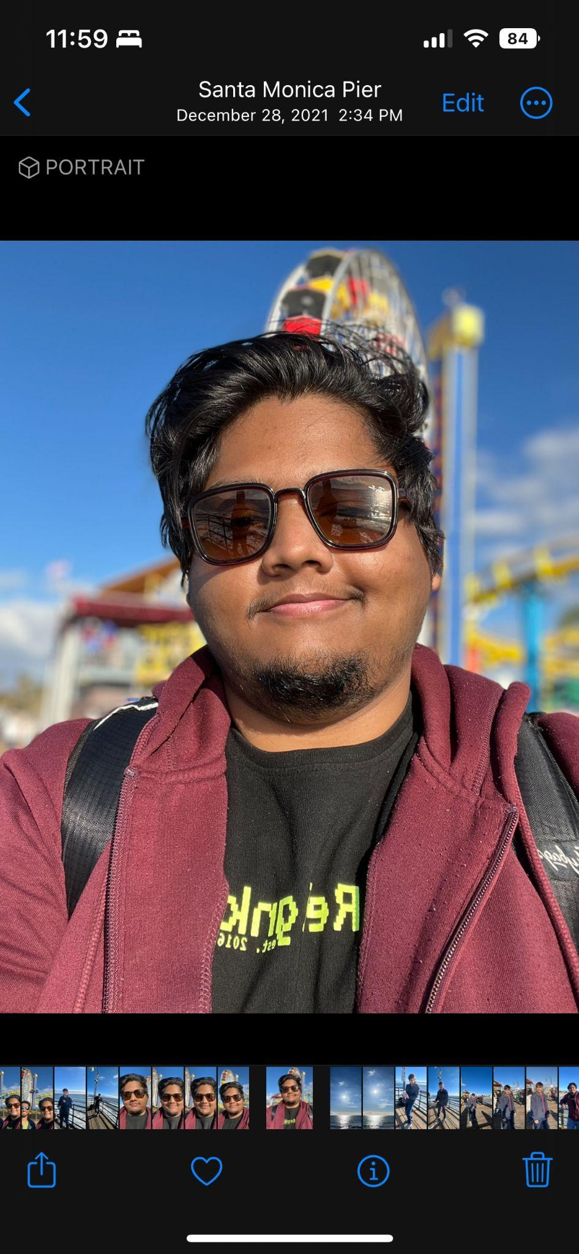
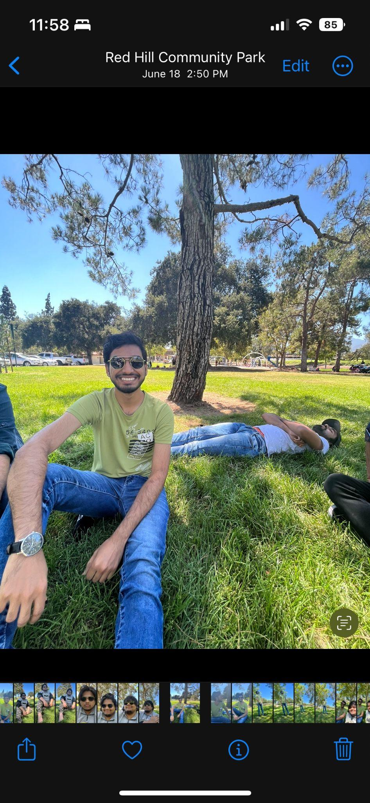

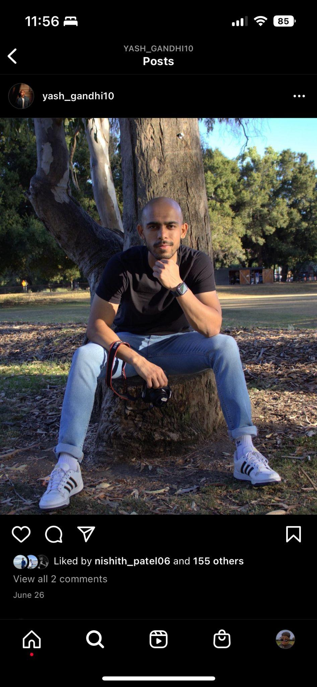
Meet Our Team
Vineet
Mihir
Vishv
Yash

